Slide 1

Advanced Software Development- end of semester project
JAVA
Flight-Gear Simulator
Course number: #60098 Lecturer: Dr. Eliahu Khalastchi Project by: Shani Maor, Dror Cohen, Noy Hadad and Jonathan Langer

Slide 2
Introduction
In this presentation, we will review our end of semester project that we developed during the ‘Advanced Software Development’ course, which deals with Java programming, with emphasis on design patterns and programming principles such as SOLID and GRASP. In this project, we built a desktop application using JavaFX in MVVM architecture, that used as a tool for “projecting” flights and detect anomalies.

Slide 3
Project Milestones
Implementation of simple anomaly detector using linear regression.
Planning the work on the project and designing it using agile methodology (SCRUM)
1
2
3
4
5
FINAL VERSION Done.
Implementation of StatLib API that providing statistical functions such as: average, variance etc.
Implementation of anomaly detection server, using bridge pattern.
Building the project according to our design. Creating UML diagrams according to our project.

Slide 4
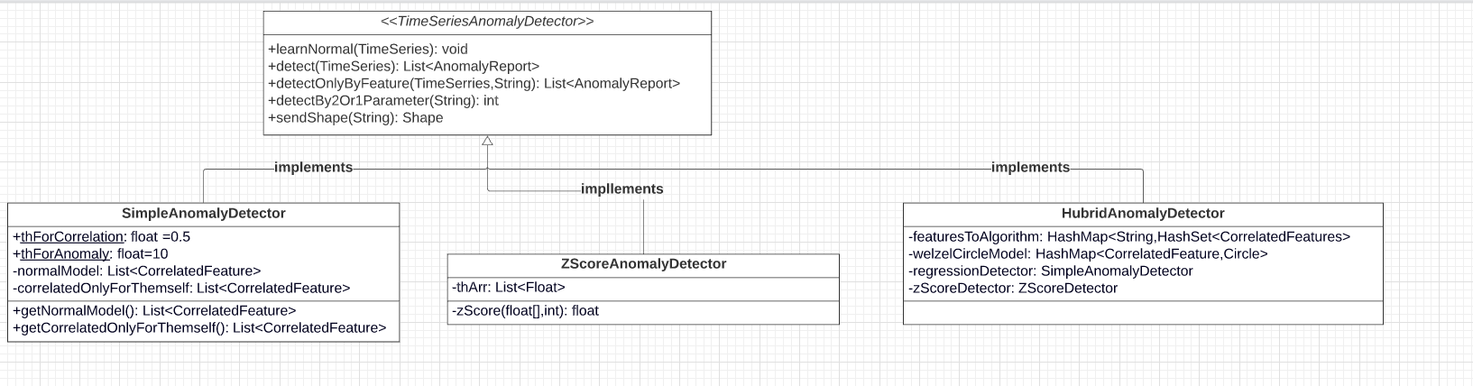
Class Diagram-Detector

Slide 5
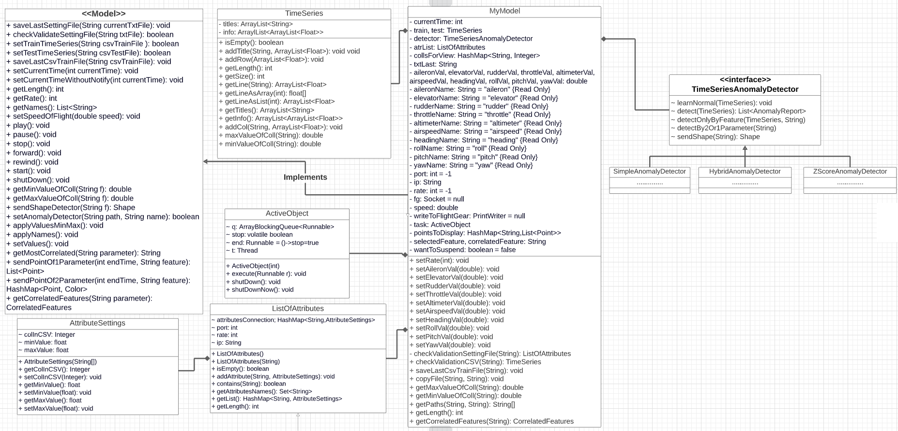
Class Diagram-Model

Slide 6
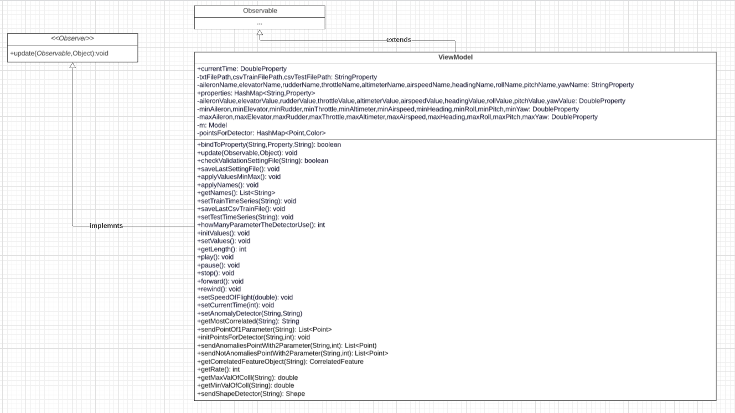
Class Diagram-ViewModel

Slide 7
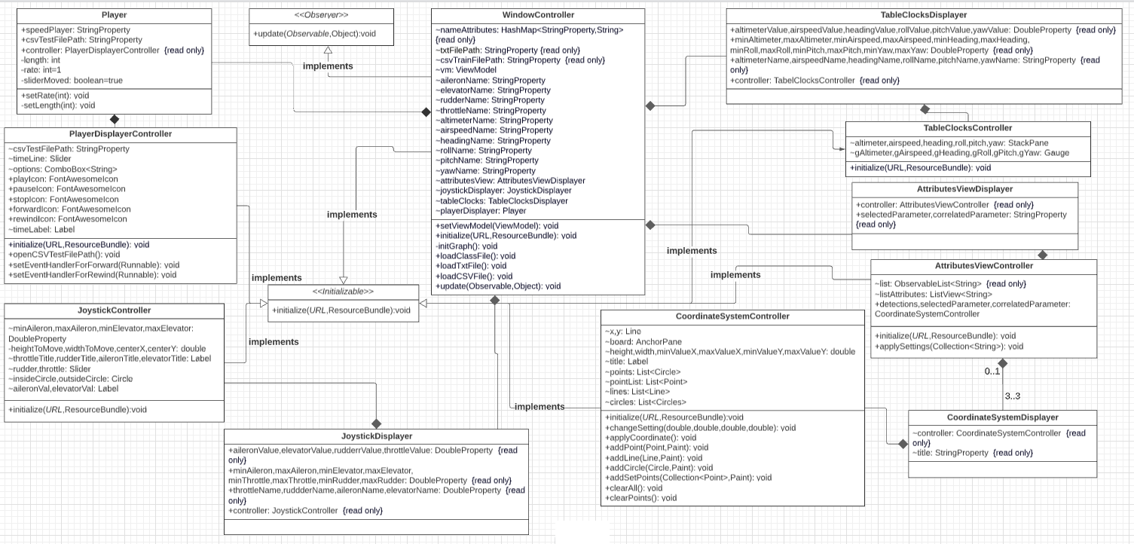
Class Diagram-View

Slide 8
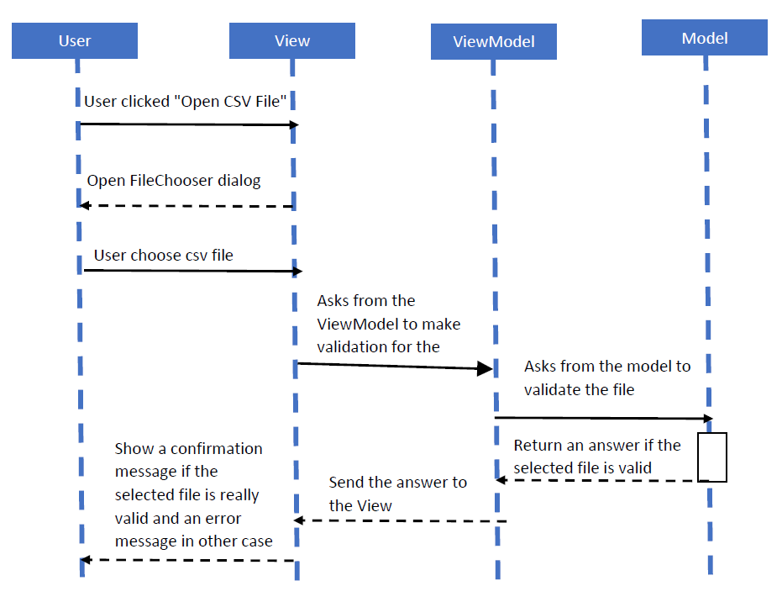
Sequence Diagram
The sequence diagram which describing the file opening scenario

Slide 9
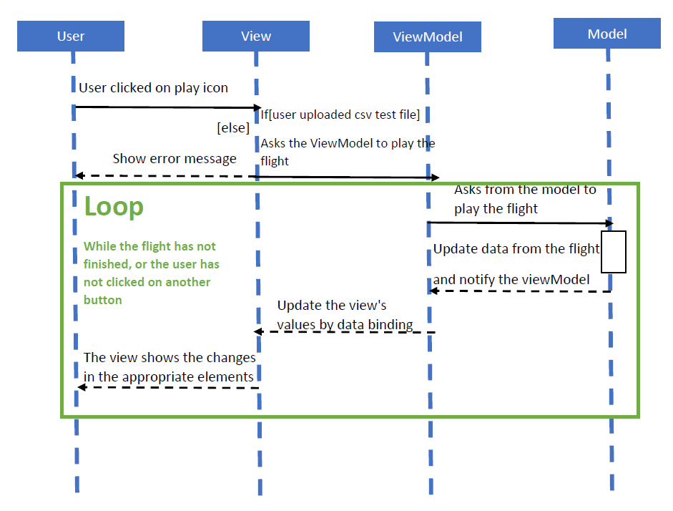
Sequence Diagram
The sequence diagram which describing the scenario of pressing the “play” button

Slide 10
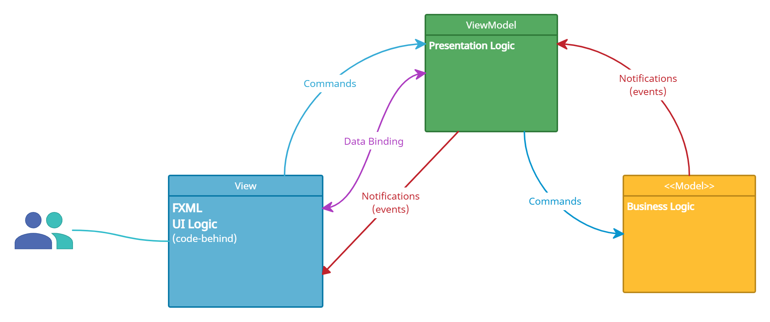
JavaFX GUI
With MVVM Architecture
Extensibility
Has the ability to replace or add new pieces of the code.
Testability
Make sure it works right when written and keeps working even when things change in maintenance.
Maintainability
A clean separation between different kinds of code.
Cause moving out new releases quickly.

Slide 11
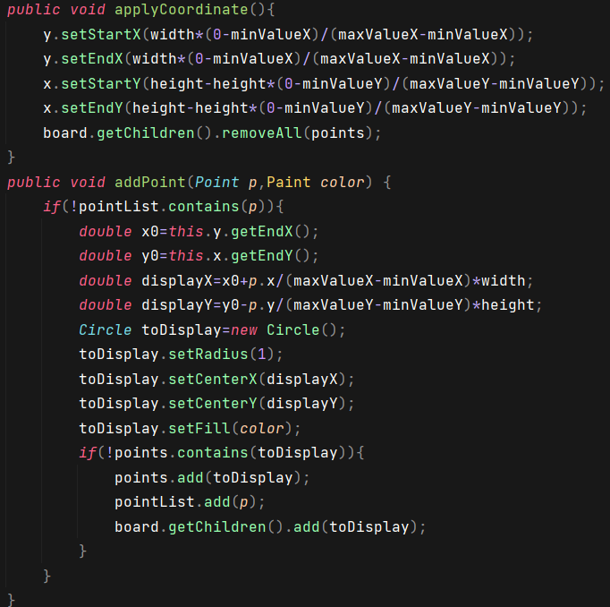
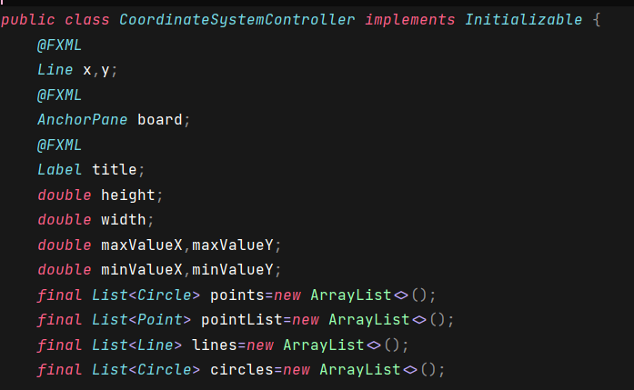
Let’s get into some code…
CoordinateSystem
Some methods
Data members

Slide 12
Movie Time

Slide 13


Slide 16

Our Team
Thank you for watching!
Omer Berger
I am Noa Cohen
B.Sc. Compute Science Student 2ND year
B.Sc. Compute Science Student 2ND year
https://www.linkedin.com/in/omerberger/
https://www.linkedin.com/in/noalecohen1/
oberger96@gmail.com
noalecohen1@gmail.com
https://github.com/OBerger96
https://github.com/noalecohen1

